Slide 1
Dynamic Programming Longest Common Subsequence (LCS)

Slide 2
What is a subsequence ?
Sequence: ABCBDABBBACD

Slide 3
What is a subsequence ?
Sequence: ABCBDABBBACD
BDBBC is a subsequence

Slide 4
What is a subsequence ?
Sequence: ABCBDABBBACD
ABBD is a subsequence

Slide 5

Definition of a subsequence
${Z=z}_{1}z_{2}⋯z_{k}$ is a subsequence of ${X=x}_{1}x_{2}⋯x_{m}$ if there are indices ${1≤i}_{1}≤i_{2}≤⋯≤i_{k}≤m$ such that $x_{i_{j}}=z_{j}$ for all $1≤j≤k$
How many subsequences does $x_{1}x_{2}⋯x_{m}$ have ?

Slide 6
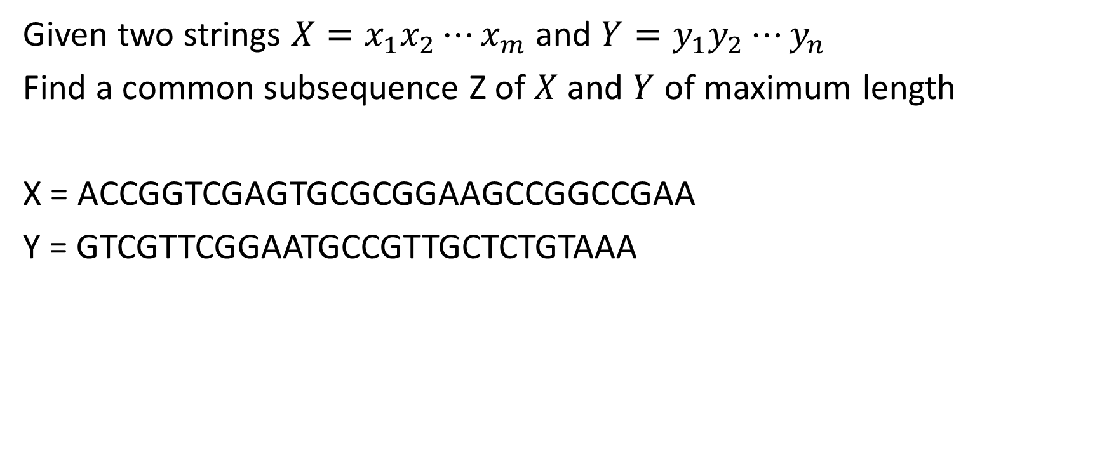
The Longest Common Subsequence Problem
Given two strings ${X=x}_{1}x_{2}⋯x_{m}$ and ${Y=y}_{1}y_{2}⋯y_{n}$
Find a common subsequence Z of $X$ and $Y$ of maximum length
X = ACCGGTCGAGTGCGCGGAAGCCGGCCGAA
Y = GTCGTTCGGAATGCCGTTGCTCTGTAAA

Slide 7
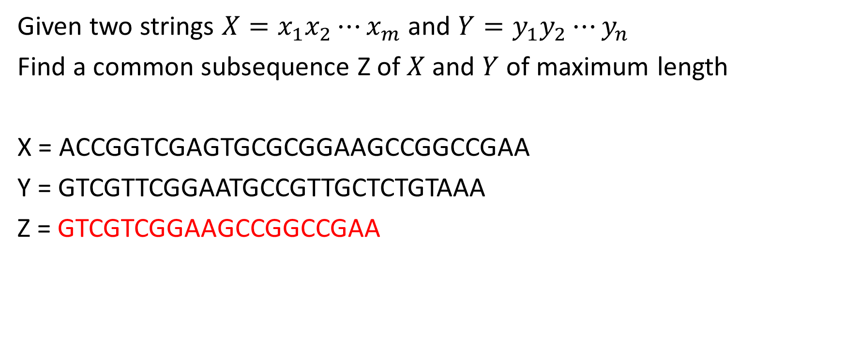
The Longest Common Subsequence Problem
Given two strings ${X=x}_{1}x_{2}⋯x_{m}$ and ${Y=y}_{1}y_{2}⋯y_{n}$
Find a common subsequence Z of $X$ and $Y$ of maximum length
X = ACCGGTCGAGTGCGCGGAAGCCGGCCGAA
Y = GTCGTTCGGAATGCCGTTGCTCTGTAAA
Z = GTCGTCGGAAGCCGGCCGAA

Slide 8
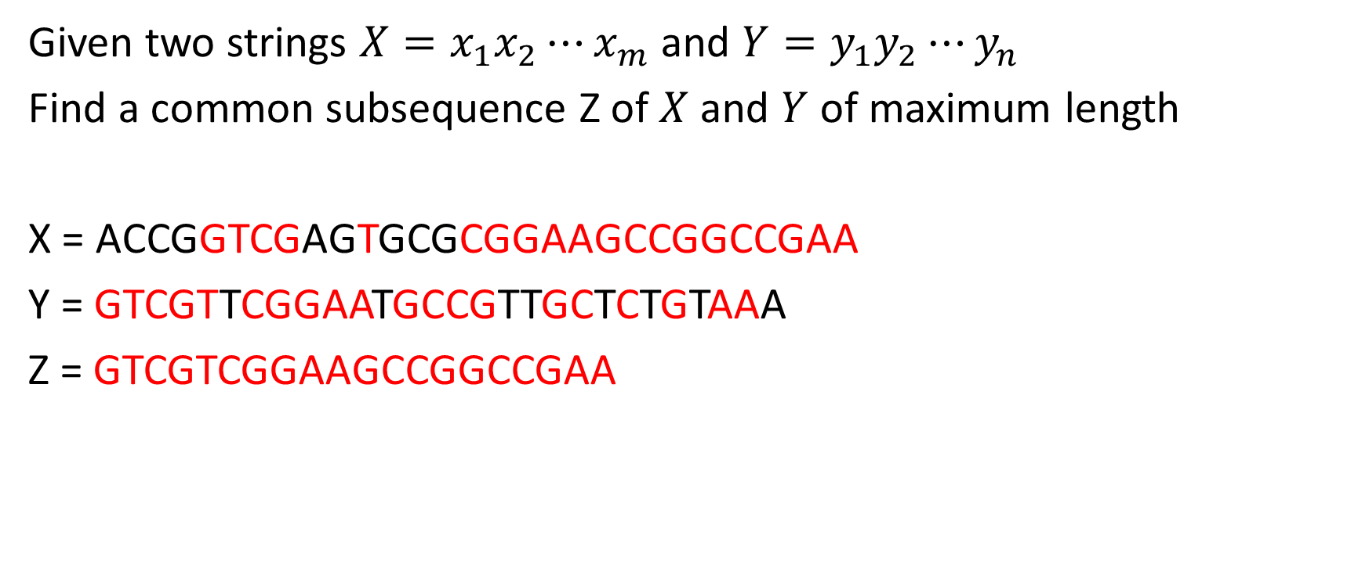
The Longest Common Subsequence Problem
Given two strings ${X=x}_{1}x_{2}⋯x_{m}$ and ${Y=y}_{1}y_{2}⋯y_{n}$
Find a common subsequence Z of $X$ and $Y$ of maximum length
X = ACCGGTCGAGTGCGCGGAAGCCGGCCGAA
Y = GTCGTTCGGAATGCCGTTGCTCTGTAAA
Z = GTCGTCGGAAGCCGGCCGAA

Slide 9
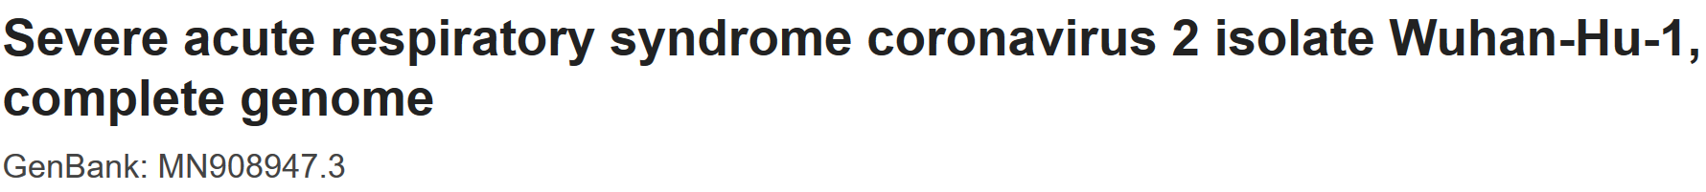
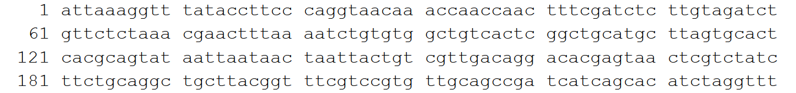
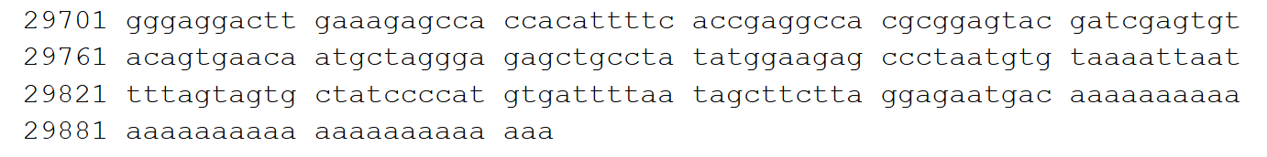
A more interesting input
https://www.ncbi.nlm.nih.gov/nuccore/MN908947
X=
……….

Slide 10

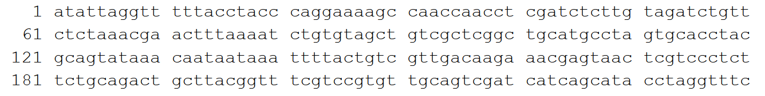
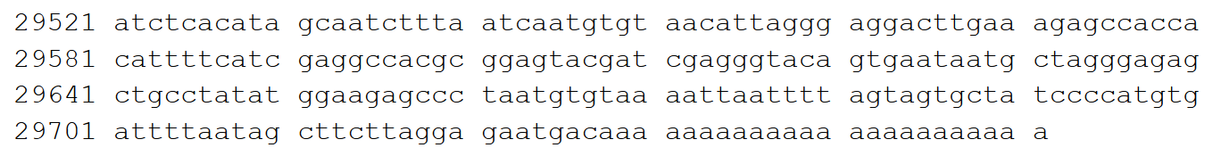
A more interesting input
https://www.ncbi.nlm.nih.gov/nuccore/NC_004718.3
Y=
……….

Slide 11

Some notation
Recall ${X=x}_{1}x_{2}⋯x_{m}$ and ${Y=y}_{1}y_{2}⋯y_{n}$
Let ${X_{k}=x}_{1}x_{2}⋯x_{k}$ (in particular $X=X_{m}$)
Let ${Y_{k}=y}_{1}y_{2}⋯y_{k}$ (in particular $Y=Y_{n}$)

Slide 12
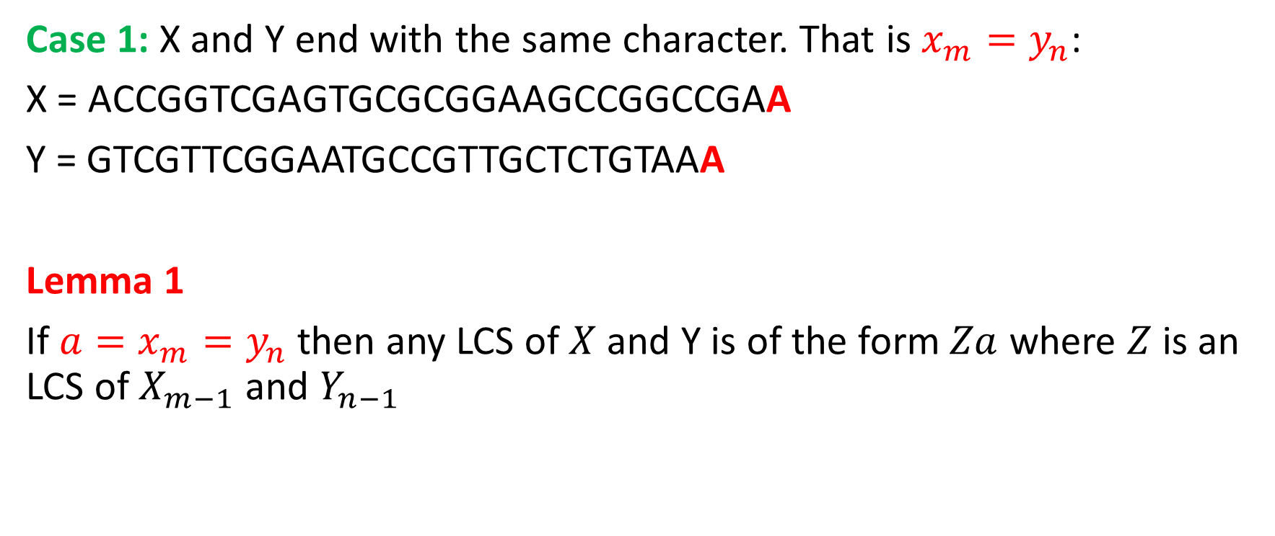
A recursive solution
Case 1: X and Y end with the same character. That is $x_{m}=y_{n}$:
X = ACCGGTCGAGTGCGCGGAAGCCGGCCGAA
Y = GTCGTTCGGAATGCCGTTGCTCTGTAAA
Lemma 1
If ${a=x}_{m}=y_{n}$ then any LCS of $X$ and Y is of the form $Za$ where $Z$ is an LCS of $X_{m−1}$ and $Y_{n−1}$

Slide 13

A recursive solution
Case 1: X and Y end with the same character. That is $x_{m}=y_{n}$:
X = ACCGGTCGAGTGCGCGGAAGCCGGCCGAA
Y = GTCGTTCGGAATGCCGTTGCTCTGTAAA
Lemma 1
If ${a=x}_{m}=y_{n}$ then any LCS of $X$ and Y is of the form $Za$ where $Z$ is an LCS of $X_{m−1}$ and $Y_{n−1}$

Slide 14
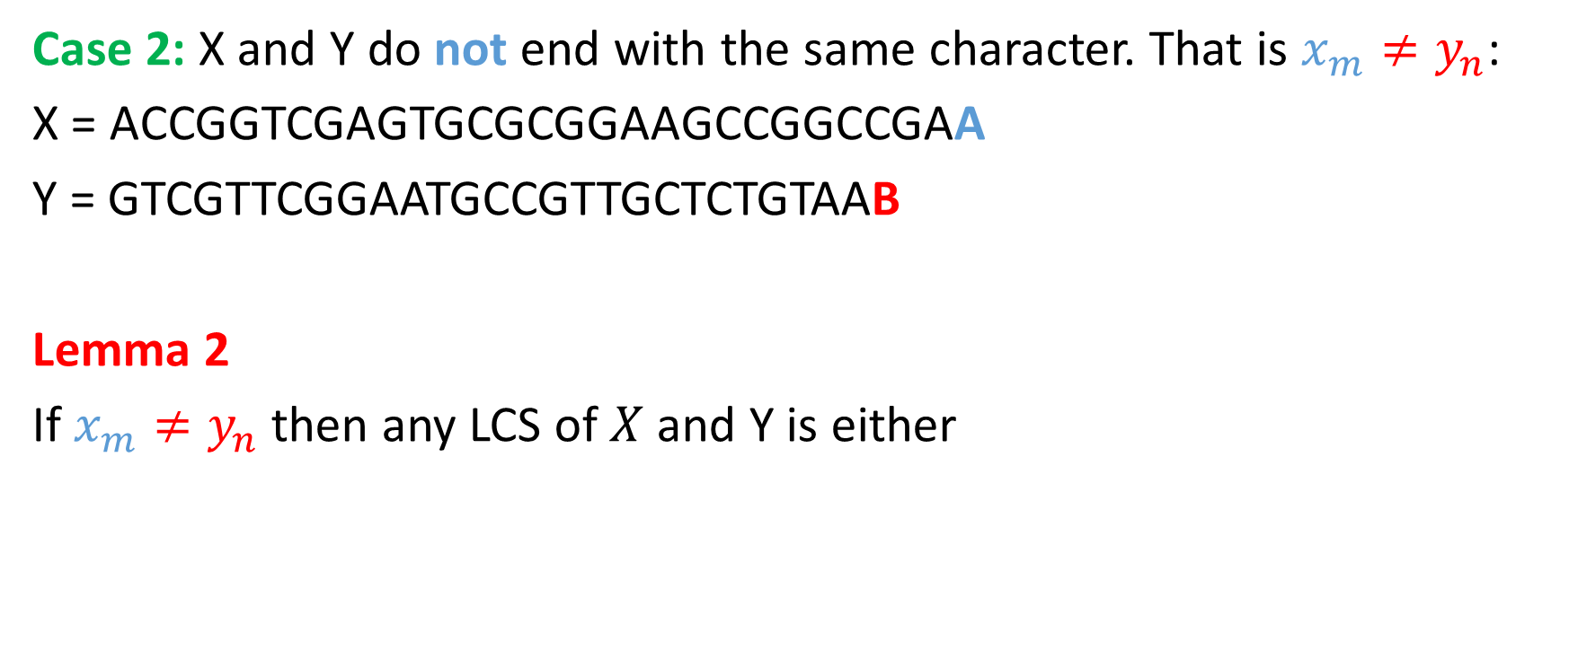
A recursive solution
Case 2: X and Y do not end with the same character. That is $x_{m}≠y_{n}$:
X = ACCGGTCGAGTGCGCGGAAGCCGGCCGAA
Y = GTCGTTCGGAATGCCGTTGCTCTGTAAB
Lemma 2
If $x_{m}≠y_{n}$ then any LCS of $X$ and Y is either

Slide 15

A recursive solution
Case 2: X and Y do not end with the same character. That is $x_{m}≠y_{n}$:
X = ACCGGTCGAGTGCGCGGAAGCCGGCCGAA
Y = GTCGTTCGGAATGCCGTTGCTCTGTAAB
Lemma 2
If $x_{m}≠y_{n}$ then any LCS of $X$ and Y is either
LCS of $X_{m−1}$ and $Y$

Slide 16
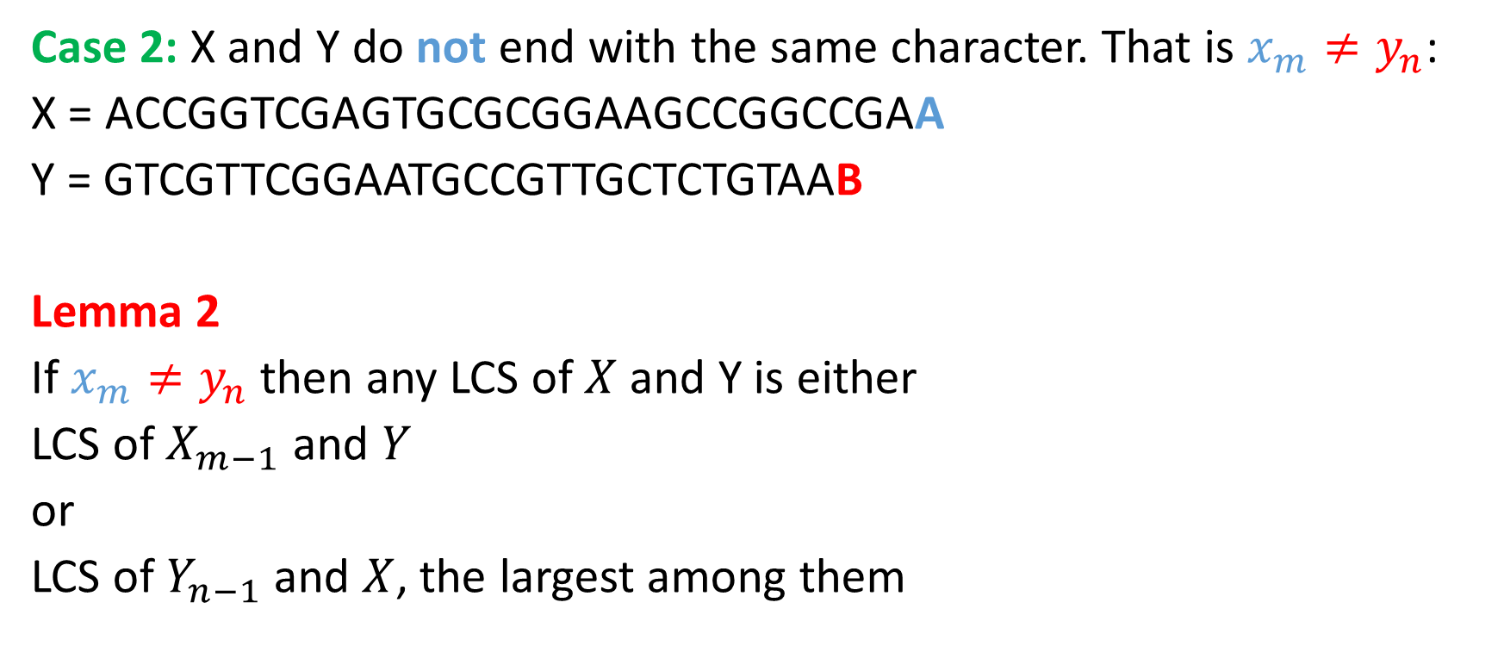
A recursive solution
Case 2: X and Y do not end with the same character. That is $x_{m}≠y_{n}$:
X = ACCGGTCGAGTGCGCGGAAGCCGGCCGAA
Y = GTCGTTCGGAATGCCGTTGCTCTGTAAB
Lemma 2
If $x_{m}≠y_{n}$ then any LCS of $X$ and Y is either
LCS of $X_{m−1}$ and $Y$
or
LCS of $Y_{n−1}$ and $X$, the largest among them

Slide 17
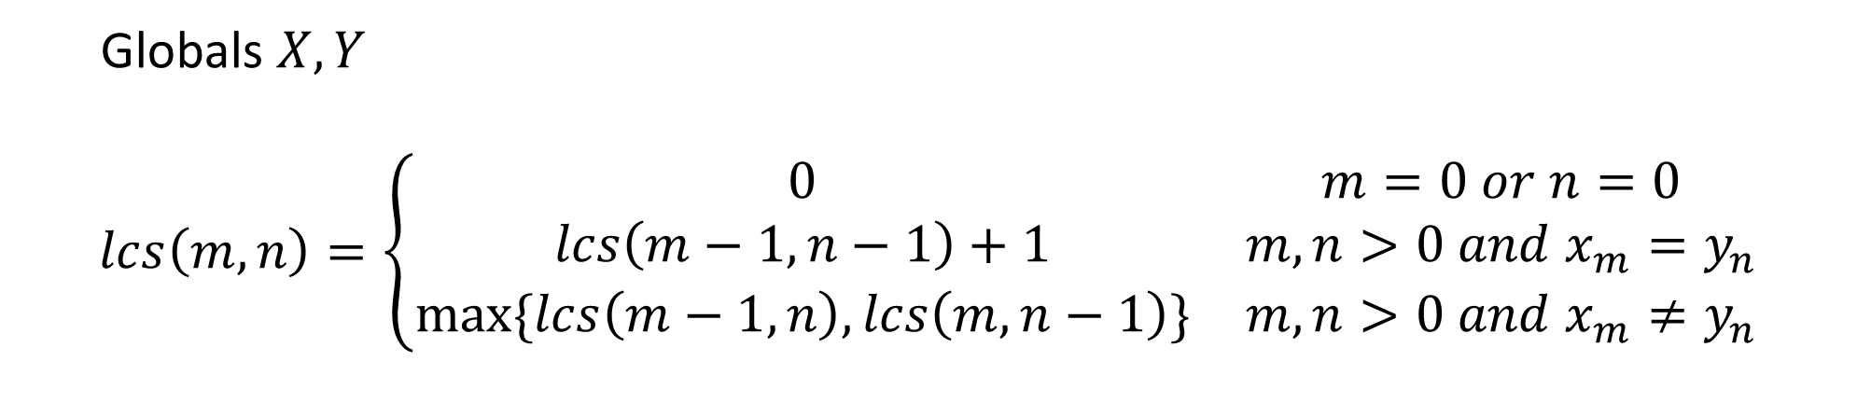
A recursive solution
Globals $X,Y$
$$lcs\left(m,n\right)=\left\{\begin{matrix}0 & m=0 or n=0 \\ lcs\left(m−1,n−1\right)+1 & m,n>0 and x_{m}=y_{n} \\ max⁡\{lcs\left(m−1,n\right),lcs\left(m,n−1\right)\} & m,n>0 and x_{m}≠y_{n}\end{matrix}\right.$$
A simple recursive procedure will solve the same problem multiple times
Solve all subproblems by filling a table in increasing subproblem size

Slide 18
LCS: Computing Length
LCS-Length(X, Y, m, n)
1 for i←1 to m do
2 c[i,0] ← 0
3 for j←0 to n do
4 c[0,j] ← 0
5 for i←1 to m do
6 for j←1 to n do
7 if x_{i} = y_{j} then
c[i,j] ← c[i-1,j-1]+1
9 b[i,j] ← ”copy”
10 else if c[i-1,j] ≥ c[i,j-1] then
c[i,j] ← c[i-1,j]
b[i,j] ← ”skipX”
13 else
c[i,j] ← c[i,j-1]
b[i,j] ← ”skipY”
16 return c, b

Slide 19
LCS: Example
0, if i=0, j=0
c[i,j] = c[i-1,j-1]+1 if i,j>0 and x_{i} = y_{j}
max ( c[i,j-1], c[i-1,j] ) if i,j>0 and x_{i} ≠ y_{i}
X
a
b
b
c
a
a
c
Y
0
0
0
0
0
0
0
0
a
0
c
0
c
0
b
0
c
0
c
0
a
0

Slide 20
LCS: Example
0, if i=0, j=0
c[i,j] = c[i-1,j-1]+1 if i,j>0 and x_{i} = y_{j}
max(c[i,j-1],c[i-1,j]) if i,j>0 and x_{i} ≠ y_{i}
a
b
b
c
a
a
c
0
0
0
0
0
0
0
0
a
0
1
1
1
1
1
1
1
c
0
1
1
1
2
2
2
2
c
0
1
1
1
2
2
2
3
b
0
1
2
2
2
2
2
3
c
0
1
2
2
3
3
3
3
c
0
1
2
2
3
3
3
4
a
0
1
2
2
3
4
4
4

Slide 21
Constructing an LCS
Print-LCS(b, X, i, j)
1 if i = 0 or j = 0 then
2 return
3 if b[i,j] = “copy" then
4 Print-LCS(b,X,i-1,j-1)
5 print x[i]
6 elseif b[i,j]=“skipX" then
7 Print-LCS(b,X,i-1,j)
8 else
Print-LCS(b,X,i,j-1)
length[X] = m, length[Y] = n,
Call Print-LCS(b, X, n, m) to construct LCS
Time complexity: O(m+n).

Slide 22
LCS: Example
0, if i=0, j=0
c[i,j] = c[i-1,j-1]+1 if i,j>0 and x_{i} = y_{j}
max(c[i,j-1],c[i-1,j]) if i,j>0 and x_{i} ≠ y_{i}
a
b
b
c
a
a
c
0
0
0
0
0
0
0
0
a
0
1
1
1
1
1
1
1
c
0
1
1
1
2
2
2
2
c
0
1
1
1
2
2
2
3
b
0
1
2
2
2
2
2
3
c
0
1
2
2
3
3
3
3
c
0
1
2
2
3
3
3
4
a
0
1
2
2
3
4
4
4

Slide 23
Longest Common Subsequence
There is a need to quantify how similar they are:
Comparing DNA sequences in studies of evolution of different species
Spell checkers
Editing

Slide 24
Books
Introduction to Algorithms, Third Edition, Thomas H. Cormen, Charle E. Leiserson, Ronald L. Rivest, Clifford Stein (CLRS).
Fundamental of Computer Algorithms, Ellis Horowitz, Sartaj Sahni, Sanguthevar Rajasekaran (HSR)

Slide 25
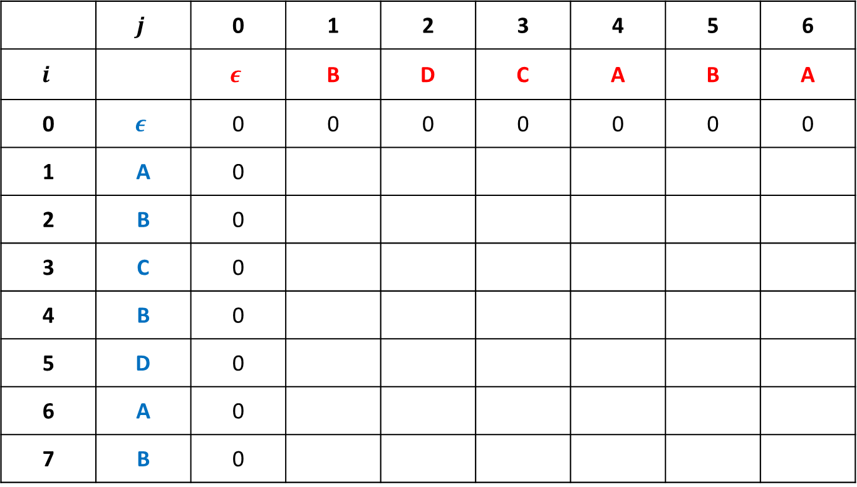
The table we need to fill
 | $$j$$ | 0 | 1 | 2 | 3 | 4 | 5 | 6
$$i$$ |  | $$ε$$ | B | D | C | A | B | A
0 | $$ε$$ | 0 | 0 | 0 | 0 | 0 | 0 | 0
1 | A | 0
2 | B | 0
3 | C | 0
4 | B | 0
5 | D | 0
6 | A | 0
7 | B | 0
Y
X

Slide 26
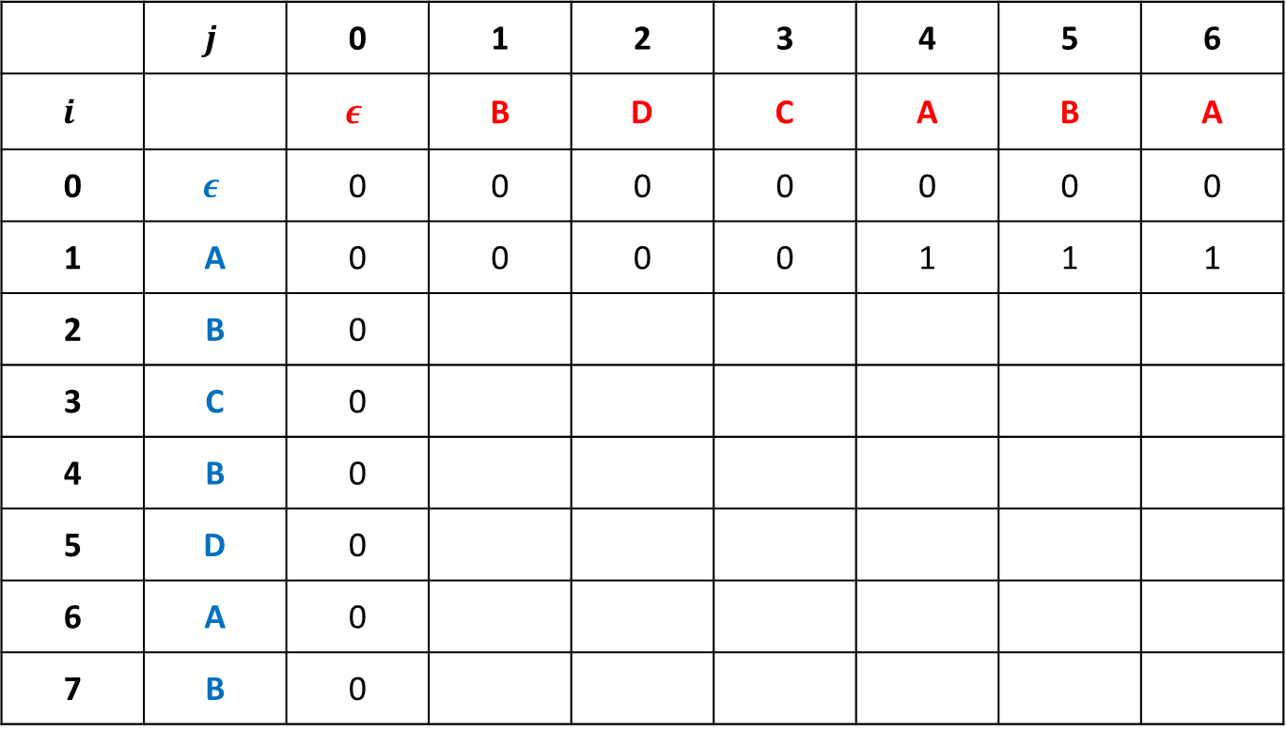
Filling the table
 | $$j$$ | 0 | 1 | 2 | 3 | 4 | 5 | 6
$$i$$ |  | $$ε$$ | B | D | C | A | B | A
0 | $$ε$$ | 0 | 0 | 0 | 0 | 0 | 0 | 0
1 | A | 0 | 0 | 0 | 0 | 1 | 1 | 1
2 | B | 0
3 | C | 0
4 | B | 0
5 | D | 0
6 | A | 0
7 | B | 0

Slide 27
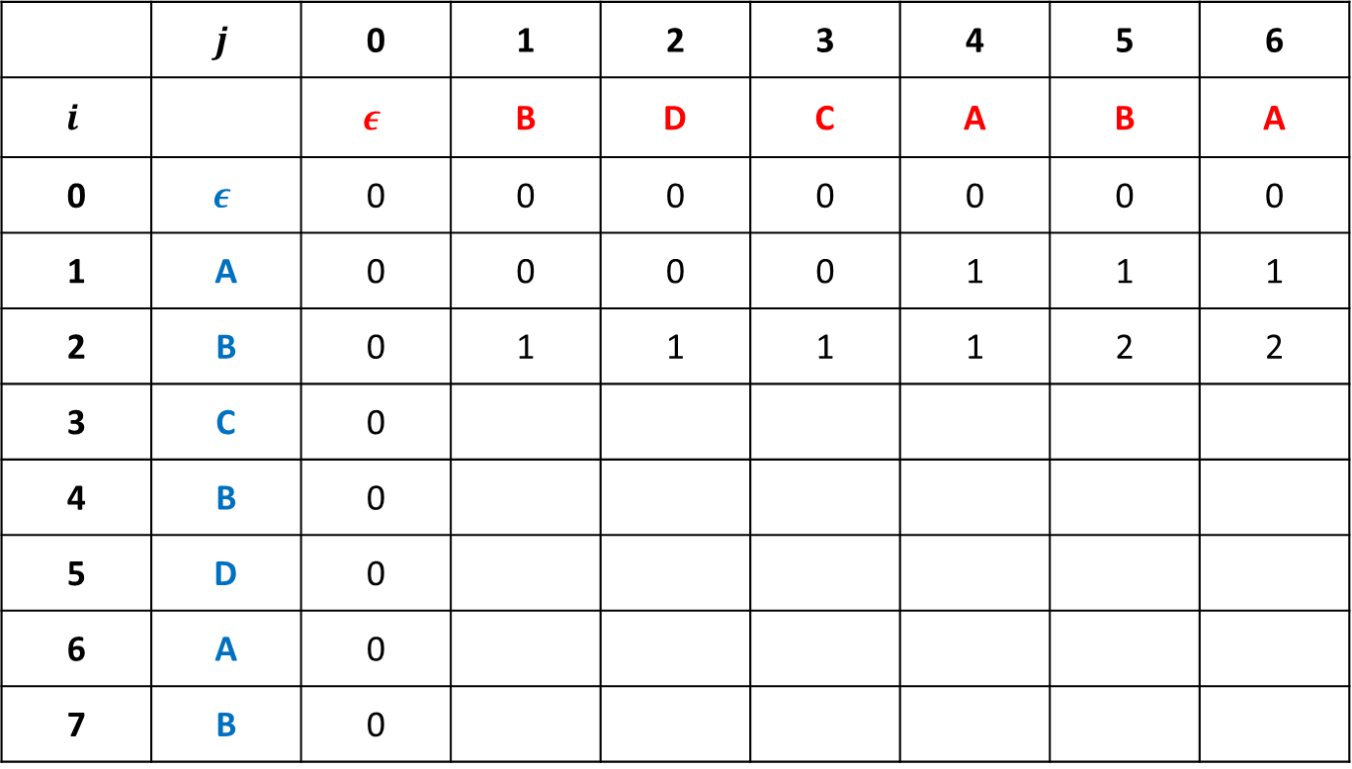
Filling the table
 | $$j$$ | 0 | 1 | 2 | 3 | 4 | 5 | 6
$$i$$ |  | $$ε$$ | B | D | C | A | B | A
0 | $$ε$$ | 0 | 0 | 0 | 0 | 0 | 0 | 0
1 | A | 0 | 0 | 0 | 0 | 1 | 1 | 1
2 | B | 0 | 1 | 1 | 1 | 1 | 2 | 2
3 | C | 0
4 | B | 0
5 | D | 0
6 | A | 0
7 | B | 0

Slide 28
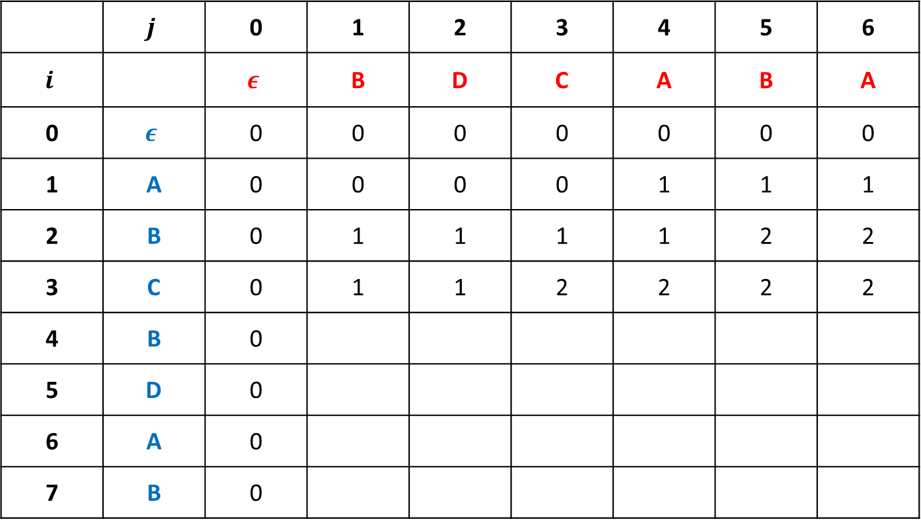
Filling the table
 | $$j$$ | 0 | 1 | 2 | 3 | 4 | 5 | 6
$$i$$ |  | $$ε$$ | B | D | C | A | B | A
0 | $$ε$$ | 0 | 0 | 0 | 0 | 0 | 0 | 0
1 | A | 0 | 0 | 0 | 0 | 1 | 1 | 1
2 | B | 0 | 1 | 1 | 1 | 1 | 2 | 2
3 | C | 0 | 1 | 1 | 2 | 2 | 2 | 2
4 | B | 0
5 | D | 0
6 | A | 0
7 | B | 0

Slide 29

Filling the table
 | $$j$$ | 0 | 1 | 2 | 3 | 4 | 5 | 6
$$i$$ |  | $$ε$$ | B | D | C | A | B | A
0 | $$ε$$ | 0 | 0 | 0 | 0 | 0 | 0 | 0
1 | A | 0 | 0 | 0 | 0 | 1 | 1 | 1
2 | B | 0 | 1 | 1 | 1 | 1 | 2 | 2
3 | C | 0 | 1 | 1 | 2 | 2 | 2 | 2
4 | B | 0 | 1 | 1 | 2 | 2 | 3 | 3
5 | D | 0
6 | A | 0
7 | B | 0

Slide 30

Filling the table
 | $$j$$ | 0 | 1 | 2 | 3 | 4 | 5 | 6
$$i$$ |  | $$ε$$ | B | D | C | A | B | A
0 | $$ε$$ | 0 | 0 | 0 | 0 | 0 | 0 | 0
1 | A | 0 | 0 | 0 | 0 | 1 | 1 | 1
2 | B | 0 | 1 | 1 | 1 | 1 | 2 | 2
3 | C | 0 | 1 | 1 | 2 | 2 | 2 | 2
4 | B | 0 | 1 | 1 | 2 | 2 | 3 | 3
5 | D | 0 | 1 | 2 | 2 | 2 | 3 | 3
6 | A | 0
7 | B | 0

Slide 31

Filling the table
 | $$j$$ | 0 | 1 | 2 | 3 | 4 | 5 | 6
$$i$$ |  | $$ε$$ | B | D | C | A | B | A
0 | $$ε$$ | 0 | 0 | 0 | 0 | 0 | 0 | 0
1 | A | 0 | 0 | 0 | 0 | 1 | 1 | 1
2 | B | 0 | 1 | 1 | 1 | 1 | 2 | 2
3 | C | 0 | 1 | 1 | 2 | 2 | 2 | 2
4 | B | 0 | 1 | 1 | 2 | 2 | 3 | 3
5 | D | 0 | 1 | 2 | 2 | 2 | 3 | 3
6 | A | 0 | 1 | 2 | 2 | 3 | 3 | 4
7 | B | 0

Slide 32

Filling the table
 | $$j$$ | 0 | 1 | 2 | 3 | 4 | 5 | 6
$$i$$ |  | $$ε$$ | B | D | C | A | B | A
0 | $$ε$$ | 0 | 0 | 0 | 0 | 0 | 0 | 0
1 | A | 0 | 0 | 0 | 0 | 1 | 1 | 1
2 | B | 0 | 1 | 1 | 1 | 1 | 2 | 2
3 | C | 0 | 1 | 1 | 2 | 2 | 2 | 2
4 | B | 0 | 1 | 1 | 2 | 2 | 3 | 3
5 | D | 0 | 1 | 2 | 2 | 2 | 3 | 3
6 | A | 0 | 1 | 2 | 2 | 3 | 3 | 4
7 | B | 0 | 1 | 2 | 2 | 3 | 4 | 4

